Slide 1
Welcome
to
Jarrett STEAM Academy
Principal Dr. Kirk Slater & Assistant Principal Dr. Margo Griffith

Slide 2
A look ahead…
Oct. 13 Picture Day
Oct. 20 PD Day/No School
Oct. 23 Parent Teacher Conferences 4:15 pm - 7:15 pm
Nov. 6-7 PD Day/No School
Nov. 20-24 Thanksgiving Break
Dec. 25 - Jan 2 Winter Break
Jan. 3 PD/No School
Jan. 15 MLK Day/No School
Feb. 19 Presidents Day/No School
March 8 PD/No School
March 11-15 Spring Break
April 26 April Break/No School
May 23 Last Day of School

Slide 3
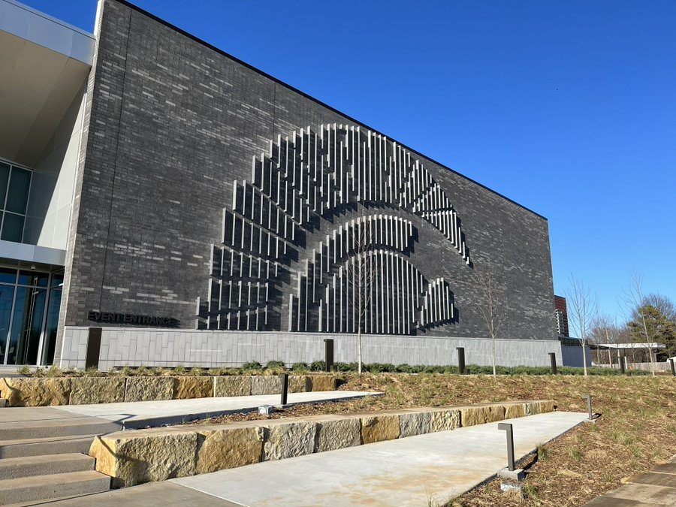
School Updates
Board policies are being strictly enforced -
Cell Phone Policy
Extra-Curricular Policies
Athletics/Fine Arts
Dances
Clubs
Attendance Goal
95% Attendance
Goal is 2% increase from last year
STEAM Showcases

Slide 4
Strategic Plan
Notes:
Throughout the strategic planning process, many people spent considerable time listening and learning about our district, including its successes and challenges.
This work helped us to focus on themes, governing priorities and objectives, which are the foundation of our new Strategic Plan.
To develop the plan, we hosted in-person and virtual interviews and focus groups with parents, community members, and staff.
We conducted multiple site visits and utilized a ThoughtExchange survey to gather feedback.

Slide 5
Strategic Plan Priorities
Success-Ready Students
We are committed to preparing all students to be college and/or career ready, with an emphasis on each student reaching their full potential.
Organizational Efficiency
We are committed to being responsible leaders and stewards of district resources.
Collaborative Culture
We are committed to engaging in proactive communication and collaboration with all stakeholders.
Quality Learning Environments
We are committed to safe and secure facilities that optimize learning.
SPS.org/StrategicPlan

Slide 6
Attendance Counts in
Trojan Nation

Slide 7
Attendance Matters
We need students in classrooms every day.
Our goals for 2023-2024
Encourage students to be in school every day.
Partner with parents to provide information and resources that support their efforts to get students to school.
Provide building and district incentives to encourage attendance.
Create a community-wide understanding of why regular attendance is important, encouraging partner involvement in supporting school attendance.
Notes:
As a district, our goal is to increase student attendance by 2 percent for 2023-2024 school year.
We want them to attend every day from Tuesday, August 22 to Thursday, May 23.
Attendance isn’t just important, it is crucial.
Every day a student is absent is a lost opportunity for learning. Unnecessary absences impact the student’s achievement and it also disrupts learning for the entire class. Attending school regularly helps children feel better about school—and themselves.
It will take all of us - our staff, our students, our parents, and our community - to create a culture where attendance in school is not seen as an option but as a necessity.

Slide 9
Last School Year 2022-2023
89.24%
Currently
90.78%
OUR GOAL
92.00%
Thank you, parents and students, for striving to be here on time, every day, all day.

Slide 10
Positive Behavior Interventions
and Support (PBIS)

Slide 11
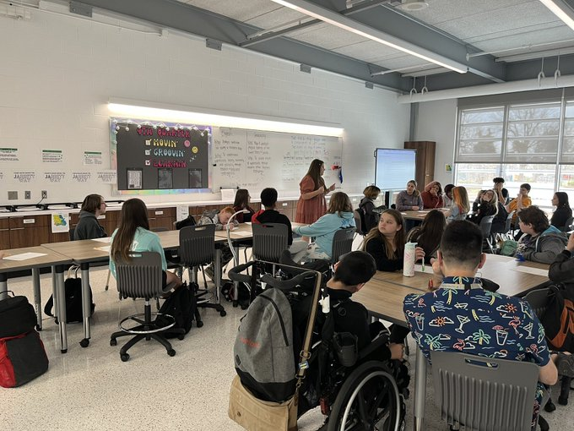
Positive Behavior Interventions and Support (PBIS)
Safe, Respectful, and Responsible
PBIS is a process for creating safer and more effective schools.
We have adopted a unified set of classroom rules.
#1: Follow adult directions promptly.
#2: Use kind words and actions.
#3: Keep hands, feet, and objects to self.
#4: Remain in your seat or area as directed.
#5: Use quiet voices and only talk when allowed.
More information will be shared soon.
Notes:
The focus of PBIS is to improve a school’s ability to teach and support positive behavior for all students.
PBIS inclues school-wide procedures and processes intended for all students and all staff in all settings.
It is an approach to creating a safe and productive learning environment where all teachers can teach and all students can learn.

Slide 12
Thank you for coming!!
Dinner starting at 5:50 pm and ending at 6:30
Classroom visits starting at 5:50 pm and ending at 6:50
Canvas/Home Access Center Sessions (6:00 pm & 6:30 pm)
Club opportunities throughout the building
Informational Tables in the foyer
(PTSA, Food Service “Free/Reduced applications”, STEAM, Athletics)

Slide 13
Notes:
Thank you and next steps for the event.
Direction to classrooms
Food
Where to ask questions

